Slide 1
Amazon Music Clustering
-By
Silviya X

Slide 2
Problem Statement
With millions of songs on music platforms, manually categorizing them is difficult. This project uses unsupervised machine learning to group similar songs based on audio features such as danceability, energy, acousticness, speechiness, valence, tempo, and duration. The goal is to identify meaningful clusters representing different musical styles, moods, or content types without predefined genre labels.
Objectives
Explore and preprocess Amazon Music song data. • Select and normalize relevant audio features. • Apply K-Means clustering to group similar songs. • Determine the optimal number of clusters using Elbow Method and Silhouette Score. • Evaluate and visualize the clusters using PCA, Davies-Bouldin Index, and cluster profiles. • Infer genre and audio characteristics of each cluster. • Provide music analytics and business insights for recommendations and playlist curation.

Slide 3
Technology Stack
• Python – Programming language • Pandas, NumPy – Data manipulation and preprocessing • Scikit-learn – StandardScaler, K-Means, PCA, and evaluation metrics • Matplotlib, Seaborn – Data visualization • Google Colab – Development environment
Dataset Description
• Dataset: single_genre_artists.csv • Records: 95,837 songs • Columns: 23 • Audio Features: Danceability, Energy, Loudness, Speechiness, Acousticness, Instrumentalness, Liveness, Valence, Tempo, and Duration • Reference Fields: Song ID, Song Name, Artist ID, Artist Name, Genres, Release Date, and popularity-related fields • Target: No predefined target label, as this is an unsupervised clustering project.

Slide 4
Project Workflow
Data Collection ↓ Data Exploration & Cleaning ↓ Feature Selection ↓ Feature Scaling using StandardScaler ↓ Elbow Method + Silhouette Score ↓ K-Means Clustering (K = 3) ↓ Cluster Evaluation ↓ PCA & Cluster Visualization ↓ Cluster Profiling & Genre Inference ↓ Business Insights & Interpretation ↓ Export Clustered Dataset

Slide 5
Data Exploration & Preprocessing
Data Exploration
• Dataset contains 95,837 songs and 23 columns. • Checked column names, data types, and statistical summary. • Verified missing values — 0 missing values. • Checked duplicates — 0 duplicate records. • Analyzed distributions of key audio features.
Preprocessing
• Selected 10 audio features relevant for clustering. • Excluded song and artist identification fields from the clustering input. • Applied StandardScaler to normalize the features because K-Means is distance-based.
Selected Features
Danceability | Energy | Loudness | Speechiness | Acousticness | Instrumentalness | Liveness | Valence | Tempo | Duration
Result: Clean and standardized feature matrix ready for clustering.

Slide 6
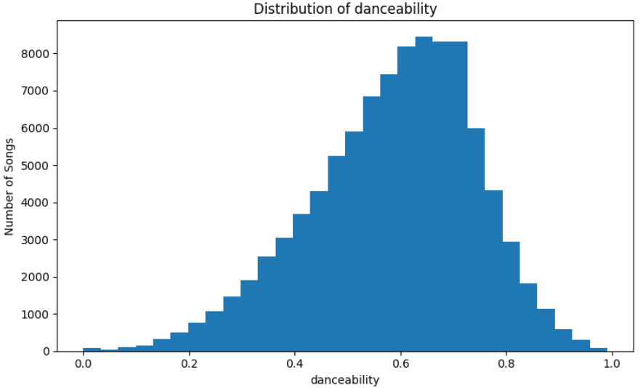
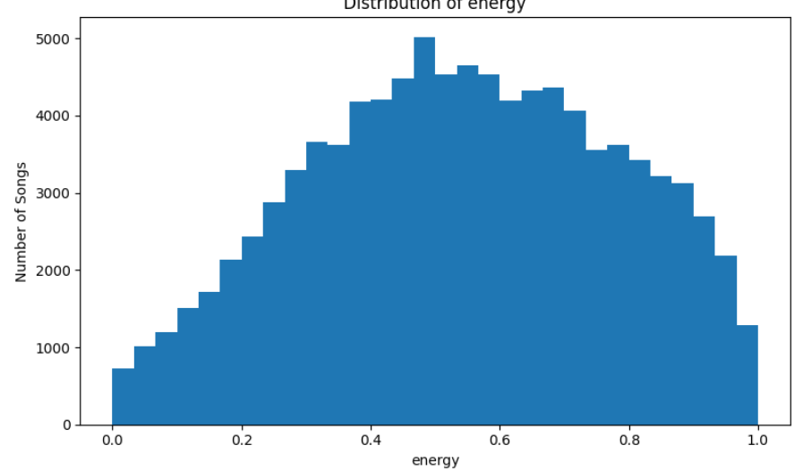
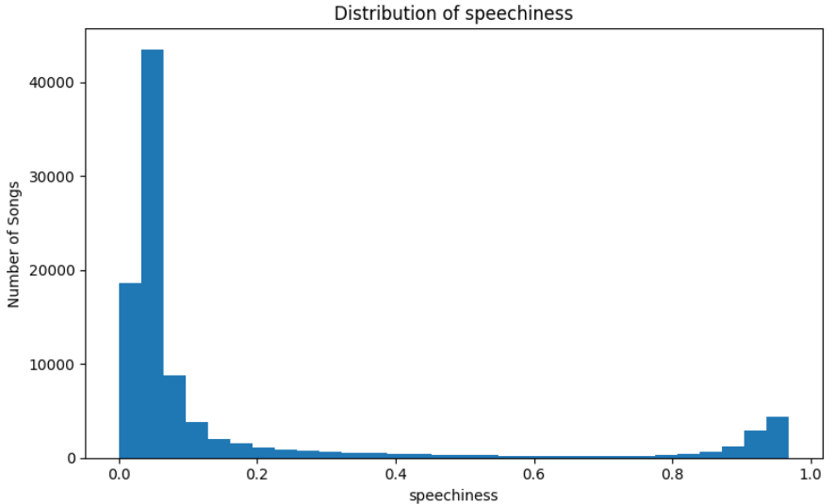
Feature Distribution Analysis
Key Observations
• Danceability: Most songs have moderate to high danceability. • Energy: Tracks show a wide range of energy levels. • Speechiness: Most songs have low speechiness, with some speech-heavy tracks.

Slide 7
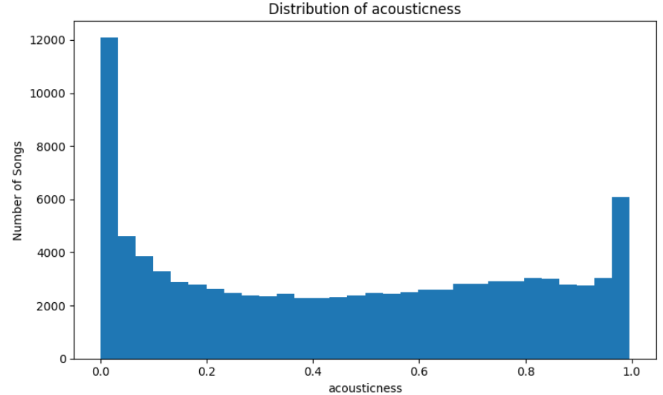
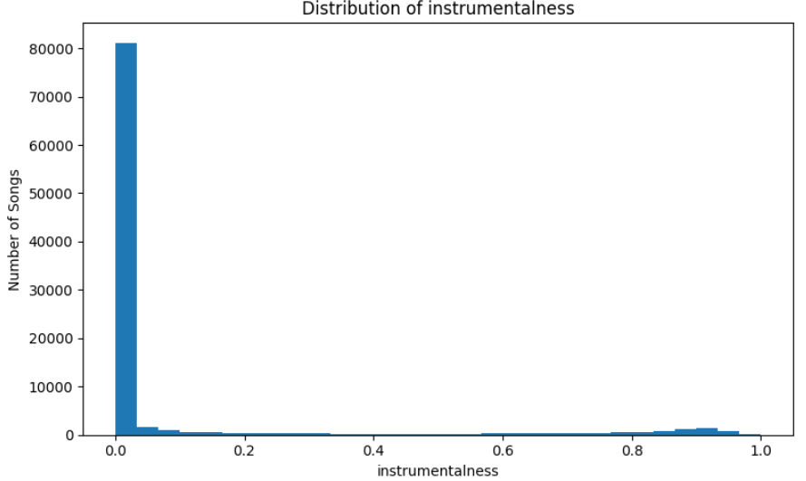
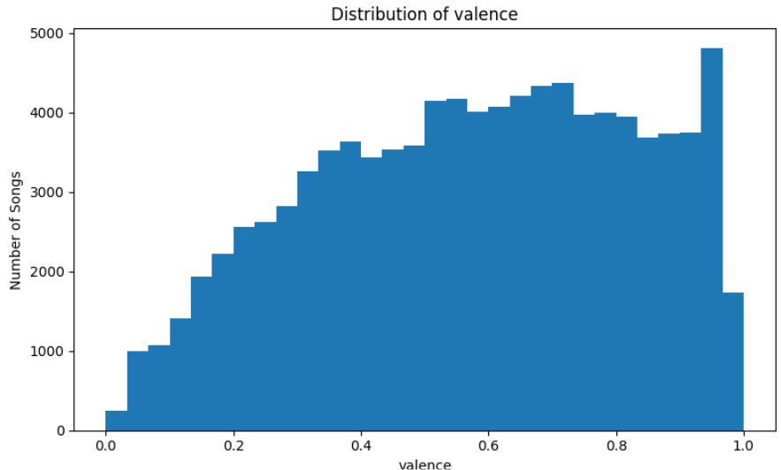
Key Observations
•Acousticness: Wide variation from low to highly acoustic songs. • Instrumentalness: Most tracks have very low instrumentalness. • Valence: Songs show a broad range of musical positivity.
Key Insight
The audio features show significant variation across songs, providing a strong basis for clustering similar audio profiles.

Slide 8
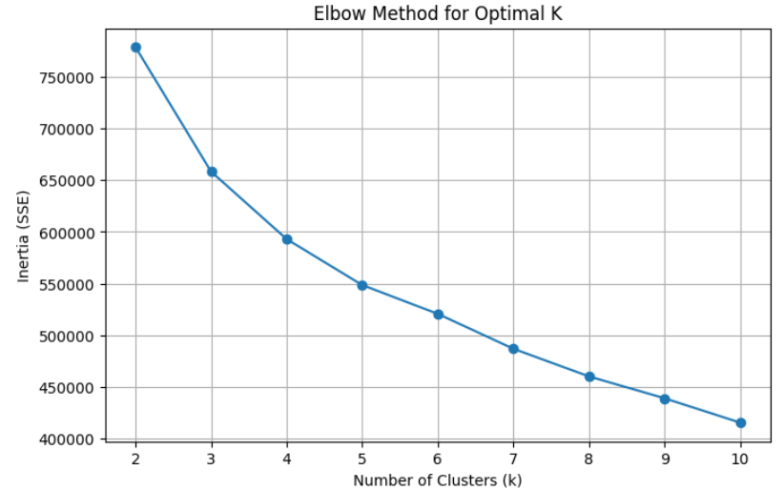
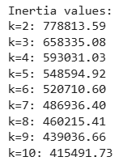
Choosing the Optimal Number of Clusters
Elbow Method
• Tested K values from 2 to 10. • Compared inertia (SSE) to identify the elbow point. • The reduction in inertia becomes more gradual as K increases.
Visualization

Slide 9
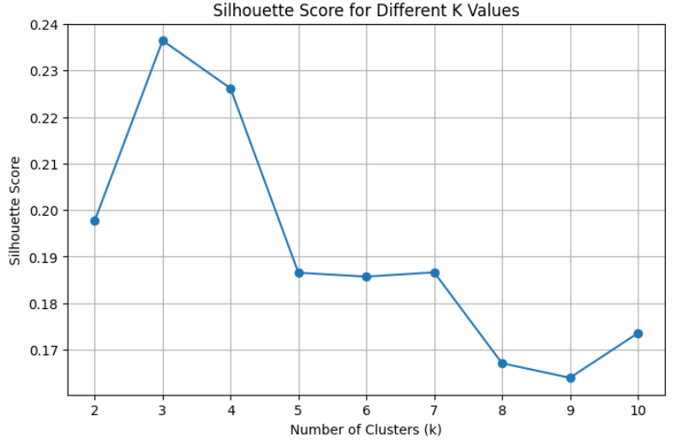
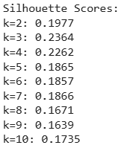
Silhouette Analysis
• Used a random sample of 10,000 songs for efficient comparison. • K = 3 achieved the highest Silhouette Score: 0.2364.
Visualization
Final Selection: Optimal number of clusters = 3
Key Insight:
K = 3 provides the best balance between cluster compactness and separation among the tested values.

Slide 10
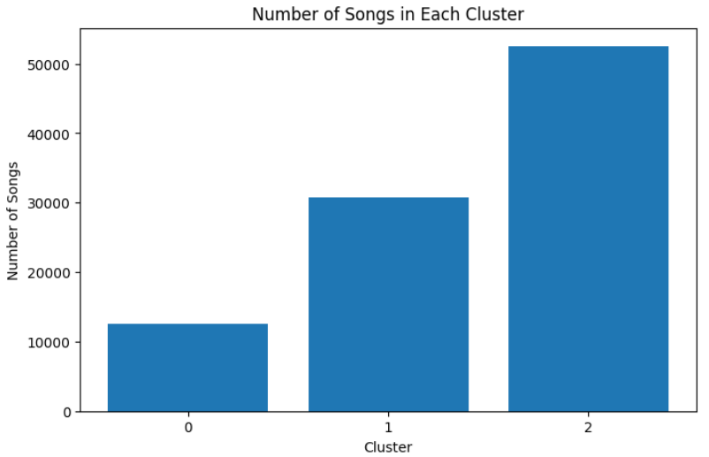
K-Means Clustering
Model Implementation
• Applied K-Means clustering to the standardized audio features. • Selected K = 3 based on Elbow Method and Silhouette analysis. • Assigned every song to one of three clusters. • Added the cluster label to the original dataset.
Final Cluster Distribution
Cluster 0: 12,513 songs
Cluster 1: 30,807 songs
Cluster 2: 52,517 songs
Visualization
Key Insight:
The model successfully grouped 95,837 songs into three distinct audio-profile clusters.

Slide 11
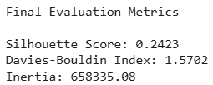
Cluster Evaluation
Evaluation Metrics
• Silhouette Score: 0.2423 Measures how well each song fits within its assigned cluster compared with other clusters.
• Davies-Bouldin Index: 1.5702 Measures similarity between clusters; lower values indicate better separation.
• Inertia: 658,335.08 Measures within-cluster compactness and supports the Elbow Method analysis.
Key Insight
The final K-Means model provides moderate cluster separation, with meaningful differences in the audio characteristics of the three groups.
Result

Slide 12
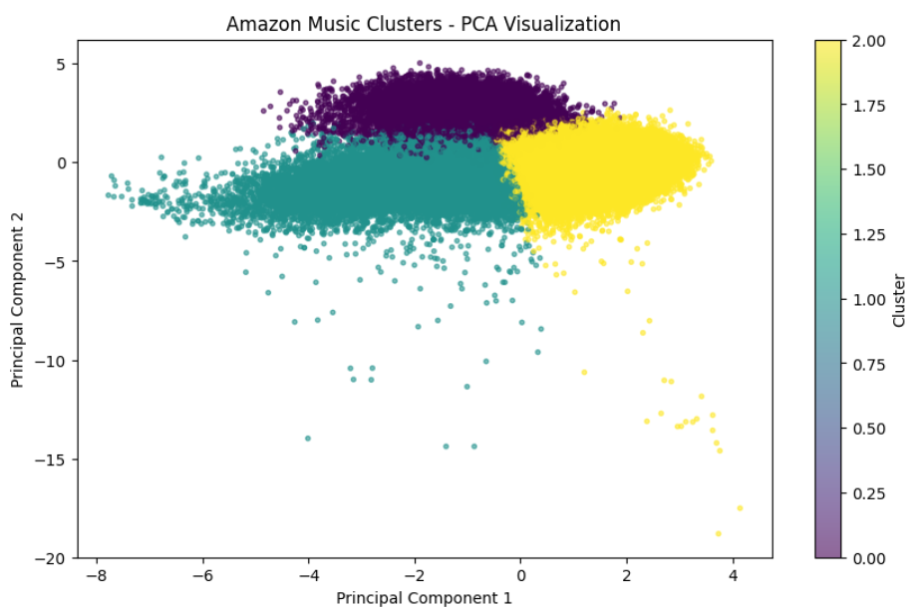
PCA Analysis & Cluster Visualization
PCA Analysis
• Applied Principal Component Analysis (PCA) to reduce the 10 standardized features to 2 components for visualization. • PC1: 27.08% of variance • PC2: 18.82% of variance • Total explained variance: 45.90%
Cluster Visualization
• Plotted the three K-Means clusters using the first two principal components. • The visualization shows three distinguishable groups with some overlap, which is expected for songs with similar audio characteristics.
Visualization:
Key Insight
PCA provides a 2D view of the clustering structure and helps interpret how the three audio-profile clusters are distributed.

Slide 13
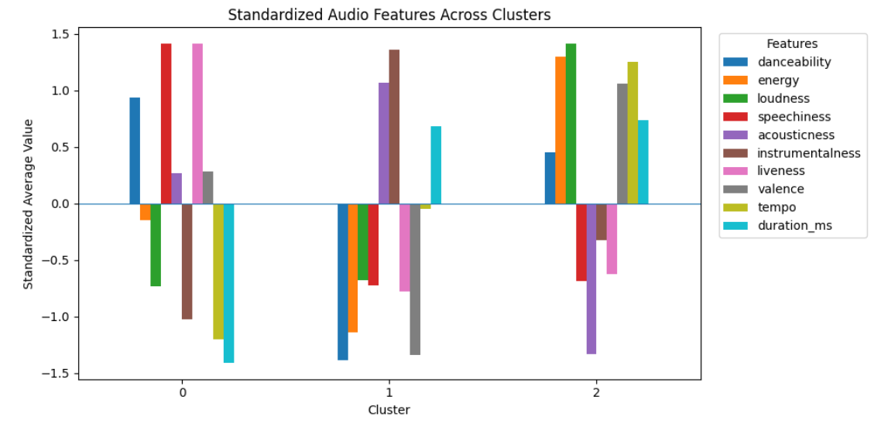
Cluster Profiling
Cluster Characteristics
Cluster | Key Audio Characteristics | Profile
Cluster 0 | Very high speechiness (≈ 0.83), higher liveness, shorter duration | Speech / Spoken-Content
Cluster 1 | High acousticness (≈ 0.75) , highest instrumentalness, low energy | Acoustic / Instrumental
Cluster 2 | High energy (≈ 0.69), loudness, valence (≈ 0.67) and tempo (≈ 124.9 BPM)] | Energetic / Upbeat
Visualization

Slide 14
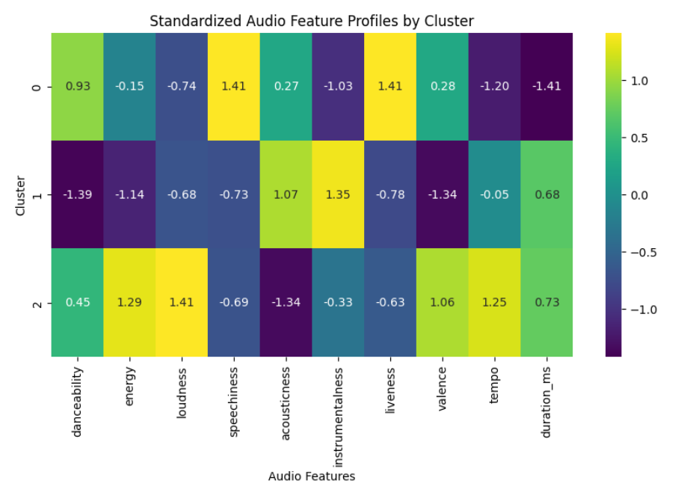
Cluster Feature Heatmap
Feature Comparison Across Clusters
• The heatmap shows how each audio feature varies across the three clusters. • Positive values indicate features that are relatively higher for the cluster. • Negative values indicate features that are relatively lower.
Visualization:
Key Insight
The heatmap clearly highlights the dominant audio characteristics that distinguish the three clusters.

Slide 15
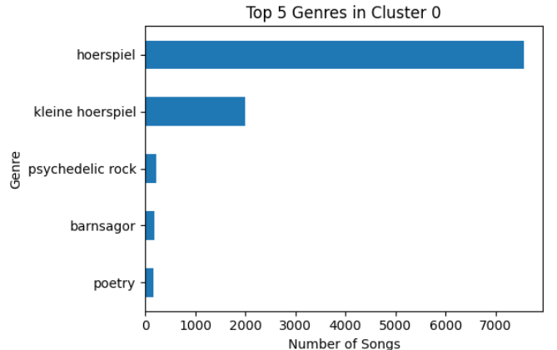
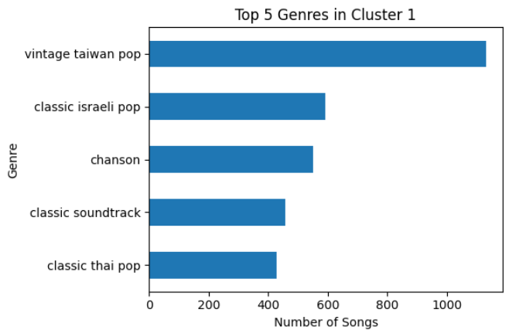
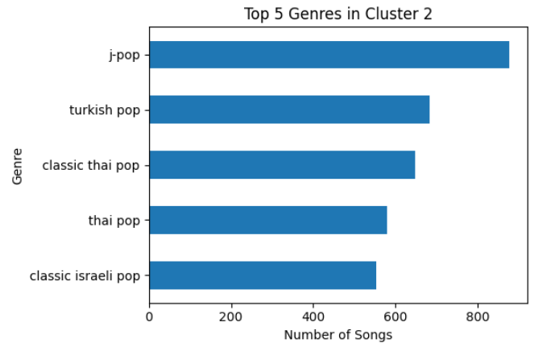
Genre Inference & Analysis
Genre Analysis
• Genre information was analyzed after clustering to interpret the audio-profile groups. • Genre labels were not used as input features for K-Means. • Each cluster contains multiple genres, showing that different genres can share similar audio characteristics.

Slide 16
Business Insights & Use Cases
Personalized Playlist Curation
• Group songs with similar audio profiles to create targeted playlists. • Cluster 2 can support energetic/upbeat playlists, while Cluster 1 can support calmer acoustic playlists.
Improved Song Discovery
• Recommend songs from the same audio-profile cluster based on a user's preferred sound characteristics.
Artist Analysis
• Help artists compare their tracks with songs having similar audio characteristics and identify relevant musical profiles.
Music Content Segmentation
• Separate spoken-content, acoustic/instrumental, and energetic content for better catalog organization and promotion.
Key Insight
The clustering results can support recommendation, playlist generation, artist analysis, and content segmentation based on audio characteristics.

Slide 17
Final Results
Model Performance
Cluster Distribution
Cluster 0: 12,513 songs
Cluster 1: 30,807 songs
Cluster 2: 52,517 songs
PCA Visualization
PC1: 27.08%
PC2: 18.82%
Total explained variance: 45.90%
Key Result
K-Means successfully grouped the 95,837 songs into three distinct audio-profile clusters based on their musical characteristics.
Metric | Result
Clusters Selected | 3
Songs Analyzed | 95,837
Silhouette Score | 0.2423
Davies-Bouldin Index | 1.5702
Inertia | 658,335.08

Slide 18
Conclusion
• Successfully analyzed and clustered 95,837 songs using unsupervised machine learning.
• K-Means with 3 clusters was selected using the Elbow Method and Silhouette analysis.
• The clusters revealed distinct audio profiles:
Cluster 0: Speech / Spoken-content
Cluster 1: Acoustic / Instrumental
Cluster 2: Energetic / Upbeat
• PCA, heatmaps, cluster profiling, and genre analysis were used to interpret the results.
• The clustering approach can support playlist curation, song discovery, artist analysis, and music-content segmentation.
Final Takeaway
Audio-based clustering provides a practical way to organize large music catalogs and identify meaningful groups without predefined genre labels.
Thank You!

